Slide 1
Using Machine Learning to Tune a Kalman Filter for Intelligent Robots
Kevin Robb with Dr. Dean Hougen

Slide 2
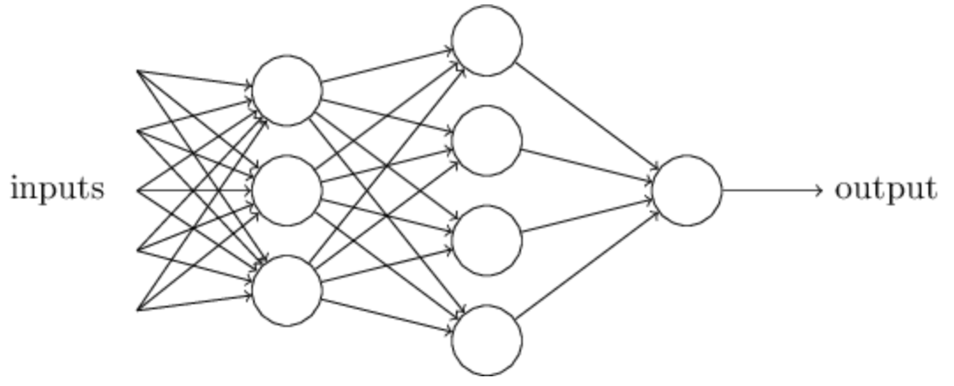
Background and Motivation
Kalman Filter
Cyclic process: a kind of average-over-time to measure and estimate “state variables” using a model
Takes uncertainties into account
Machine Learning - ANN
Takes data, produces output, and uses feedback to improve itself
Our cost function: minimize the innovation
UPDATE
OUTPUT
system state
PREDICT
MEASURE
The Kalman Filter process (simplified).
A simple artificial neural network (ANN).
Image from Neural Networks and Deep Learning.
Why use them together?
-> Mobile robots do not have a simple State Expectation Equation.
-> Kalman Filters are not dynamic enough.
Notes:
KF sets parameters and State Expectation Equation, and performs poorly if the system deviates from the expected environment.

Slide 3
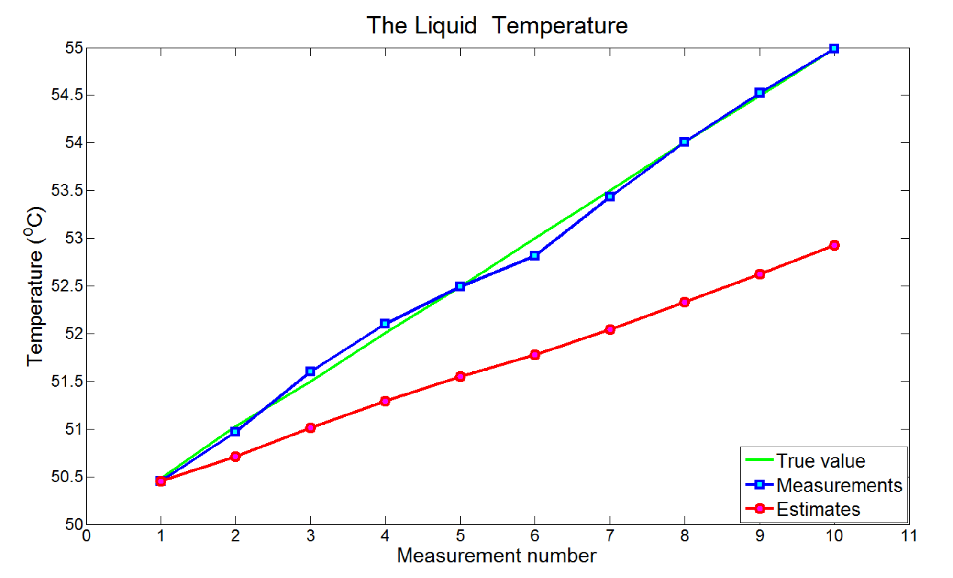
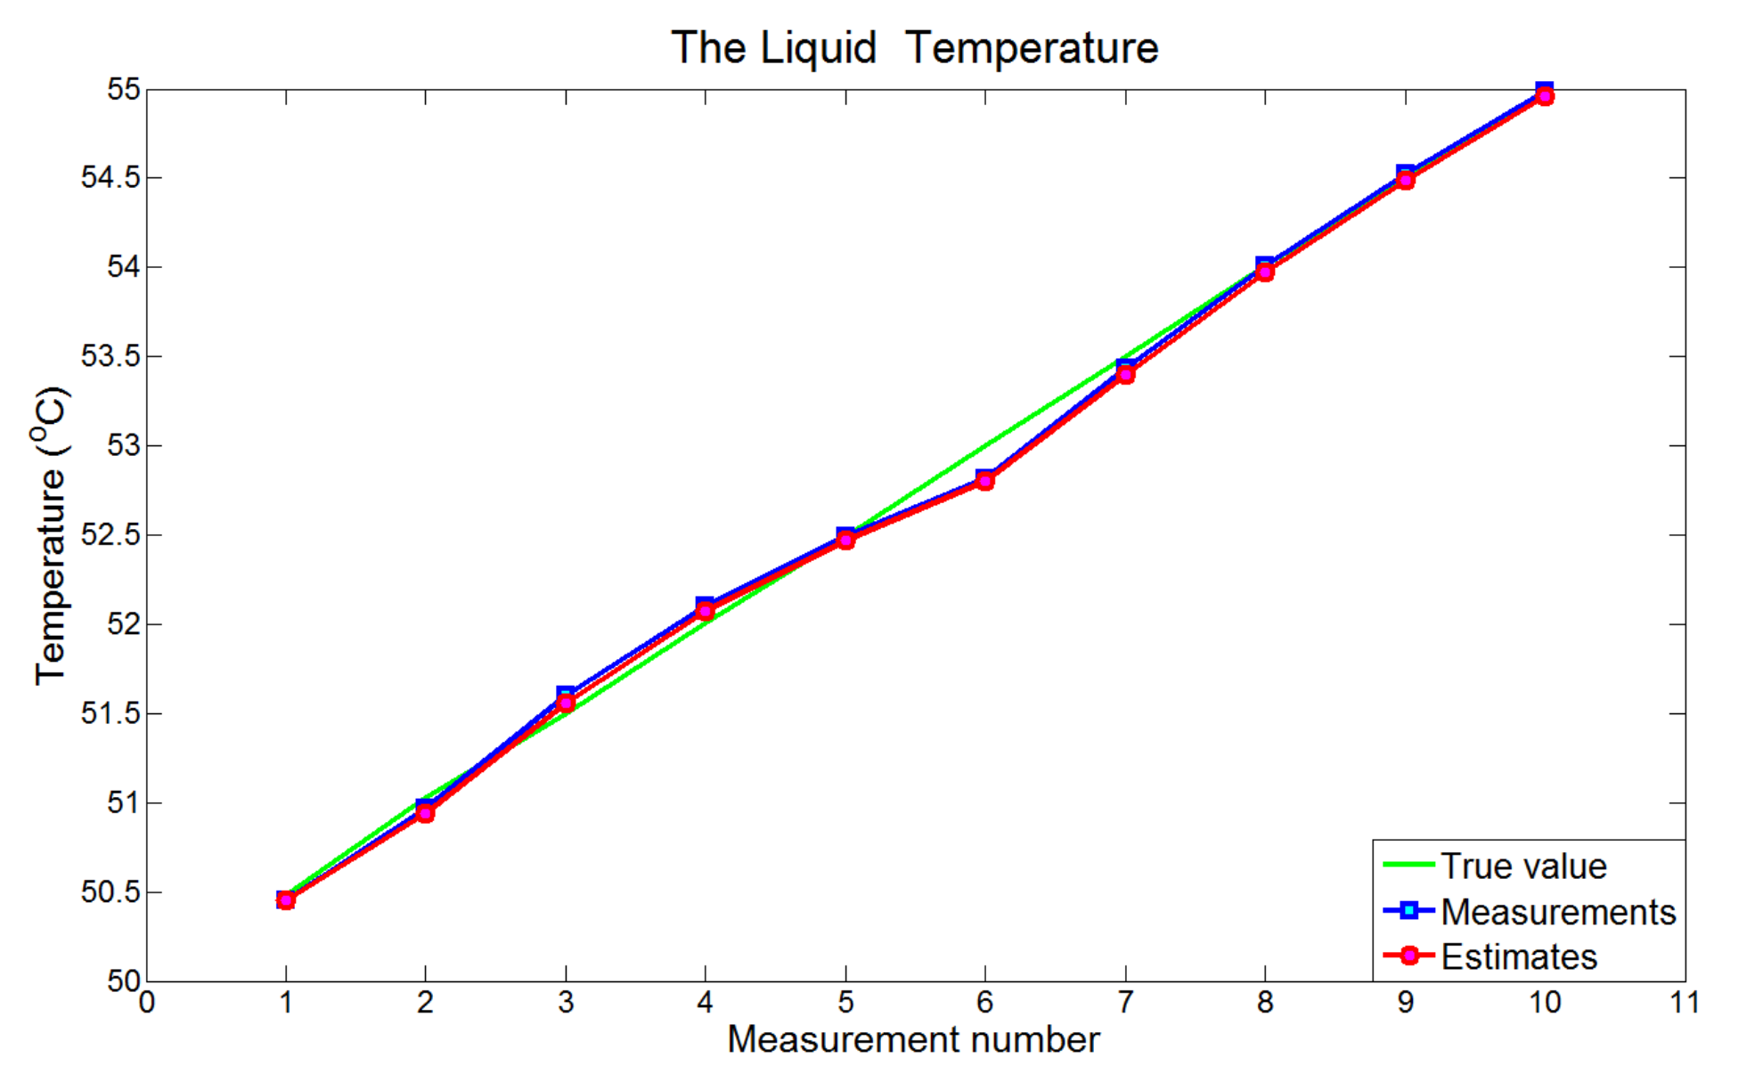
Example for part of the KF we can tune
Example: We choose the “Process Noise” parameter, representing the estimate uncertainty.
-> Mimics unpredictable deviations from the Dynamic Model.
-> We want this to be dynamic with environmental changes! (The standard KF does not do this.)
Process noise is too low -> Lag error.
Can’t keep up with changes in the true value.
Process noise is too high -> Overfitting.
Follows the measurements (ruins the point of KF).
Images from kalmanfilter.net
Notes:
Green line = true value. Blue line = measurements. Red line = estimations. We want the estimations to average out the noisy measurements and converge on the green line. ---------------------------------------------------------------------------------------------- Dynamic example: if robot is in area with lots of obstacles and reference points, we want to give high weight to our estimates from the LIDAR data. If we then move into a clearing, we want to fall back on our wheel encoder measurements for dead reckoning, without throwing out all the estimates so far and getting lost.

Slide 4
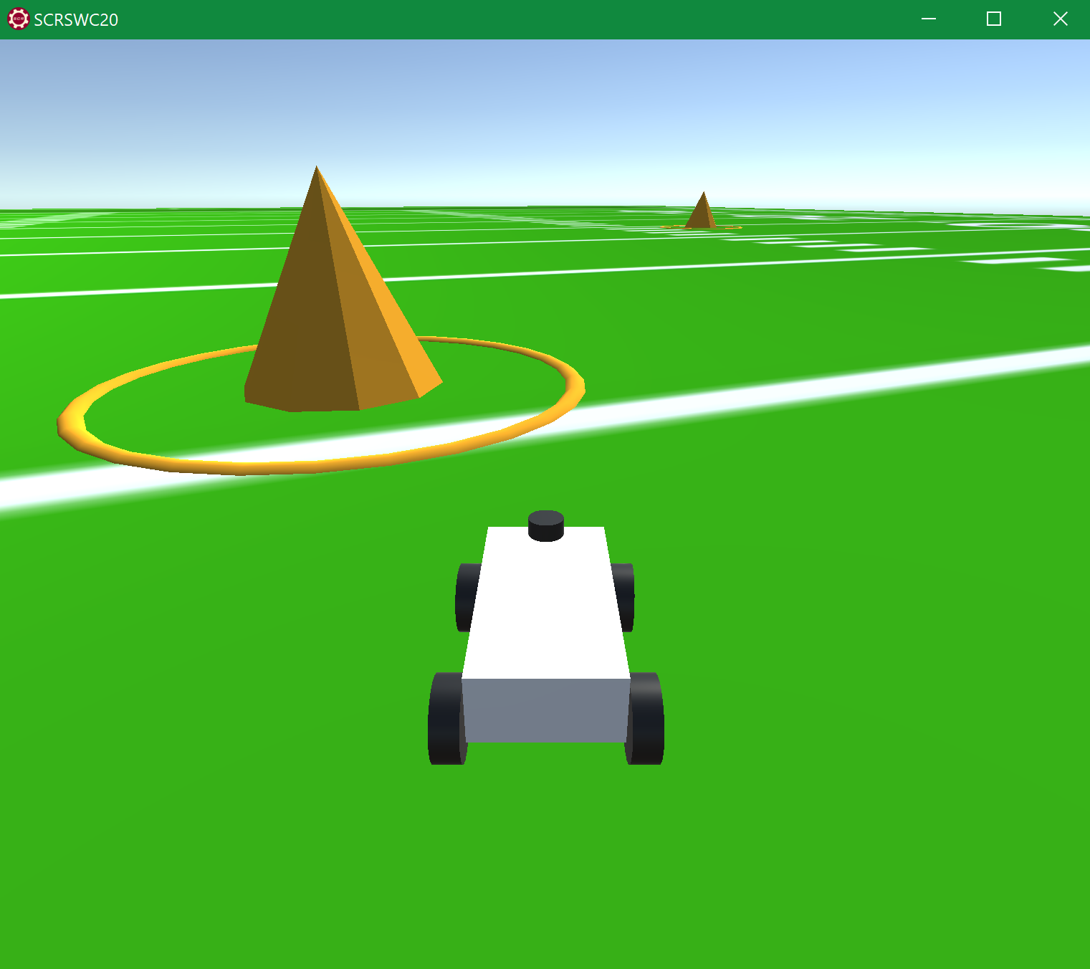
Applying this to real robots
Robots need to do several things:
Localization
Path Planning
Navigation
Tracking obstacles
Variety of sensors + KF + ML = accurate and frequently updated world model:
Able to do more complex tasks.
Safer and more precise.
Faster convergence on an optimal route.
More knowledge is better!
Screenshot of the simulator I may be using. Simulator created by Noah Zemlin for Sooner Competitive Robotics.
Notes:
Localization, Mapping, Trajectory Generation, Path Planning, Navigation, and Obstacle Avoidance. More and better knowledge about the environment improves a robot’s ability to do things.

Slide 5
References
Kalman Filter Tutorial, Alex Becker. Last modified 2018, www.kalmanfilter.net.
Michael Nielson, Neural Networks and Deep Learning (2019), Chapter 1, www.neuralnetworksanddeeplearning.com.
Jianguo Jack Wang, Weidong Ding, and Jinling Wang, “Improving Adaptive Kalman Filter in GPS/SDINS Integration with Neural Network,” School of Surveying and Spatial Information Systems, University of New South Wales, Australia. ResearchGate, 2013, www.researchgate.net/publication/251439107_Improving_Adaptive_Kalman_Filter_in_GPSSDINS_Integration_with_Neural_Network
Justin Kleiber, IGVC Kalman Filter Derivation, Sooner Competitive Robotics, Intelligent Ground Vehicle Competition design document submission, March 16th 2020.
Noah Zemlin, SCR Software Challenge Simulator, Sooner Competitive Robotics, 2020, github.com/SoonerRobotics/SCR-SWC-20

